Slide 1
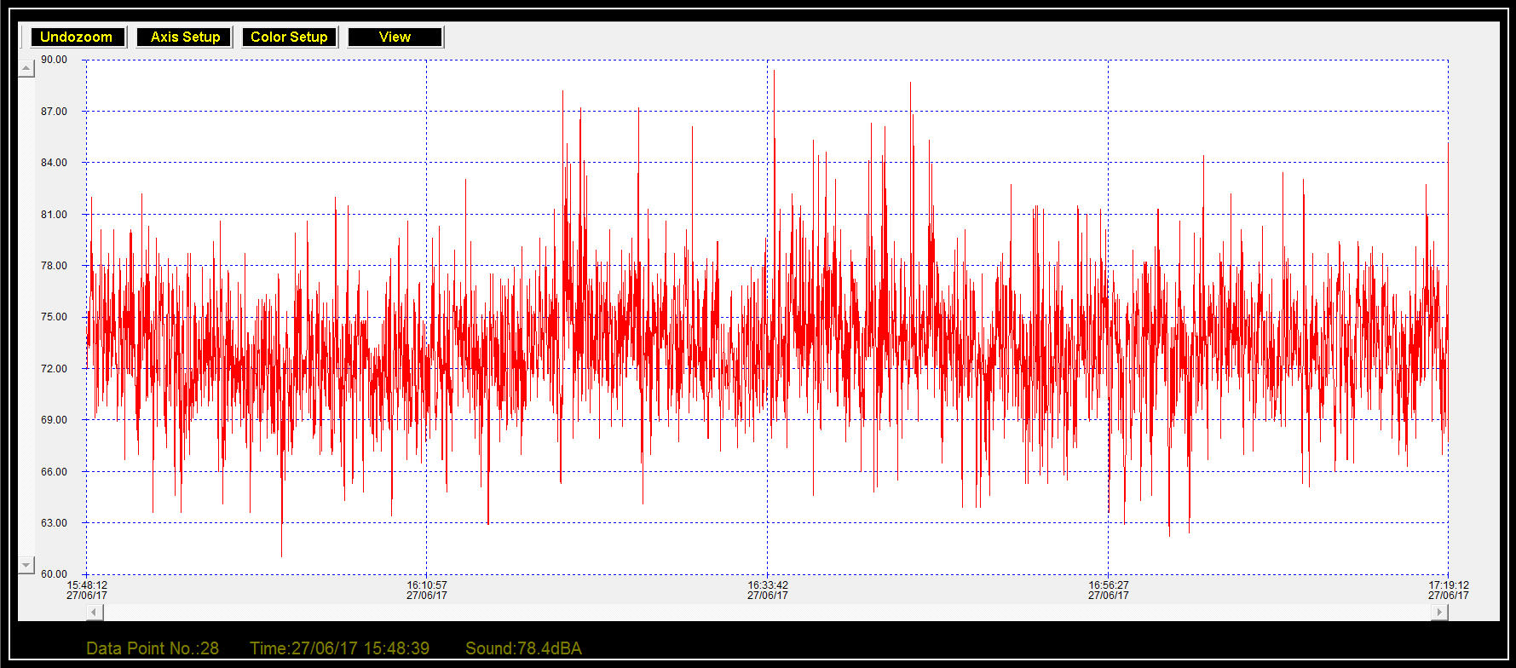
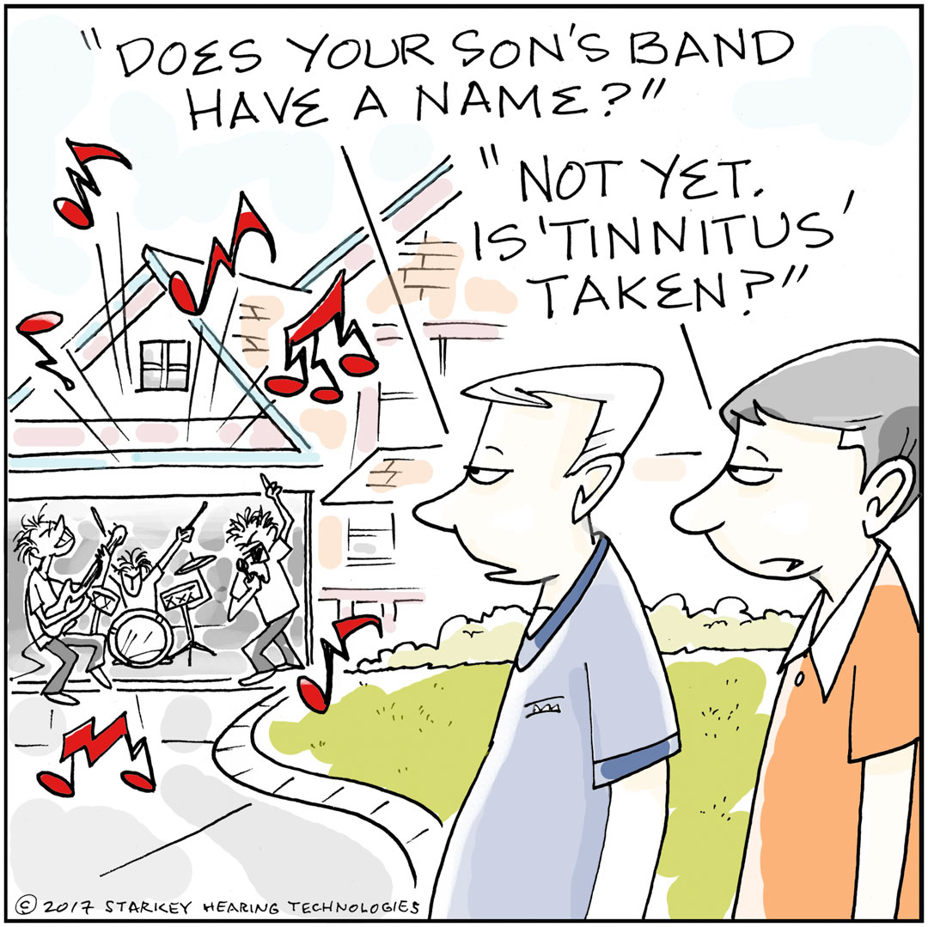
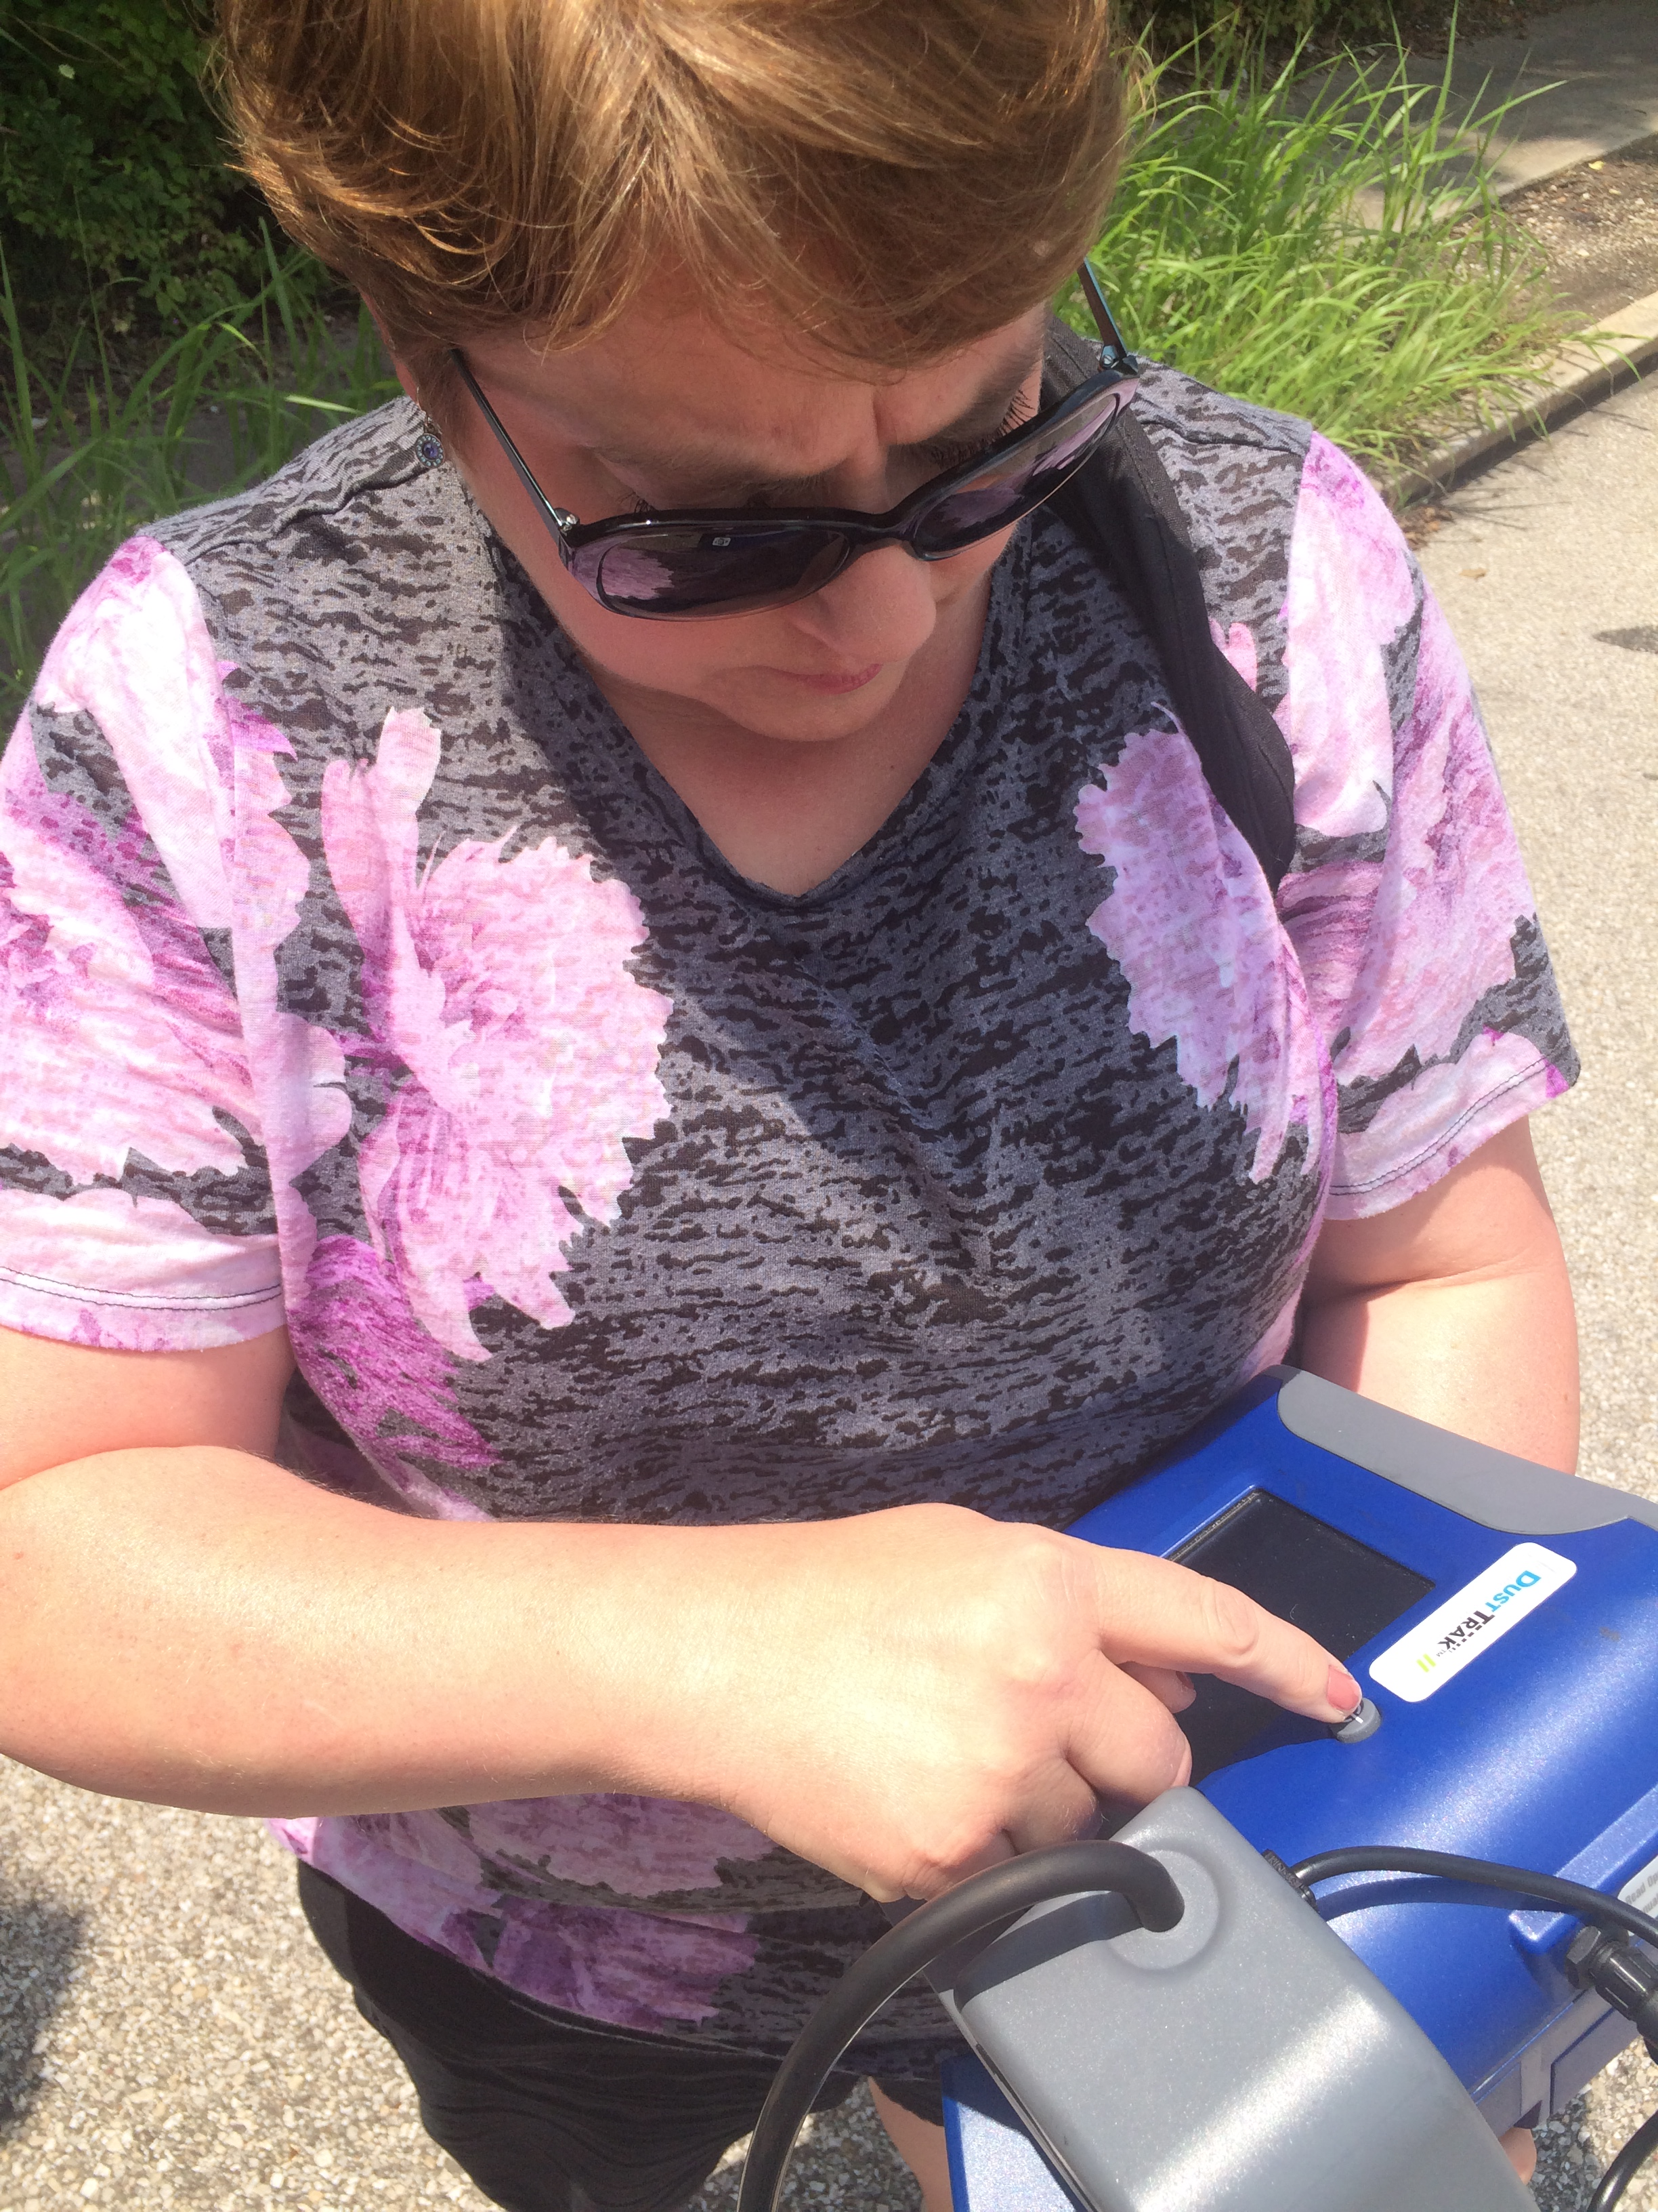
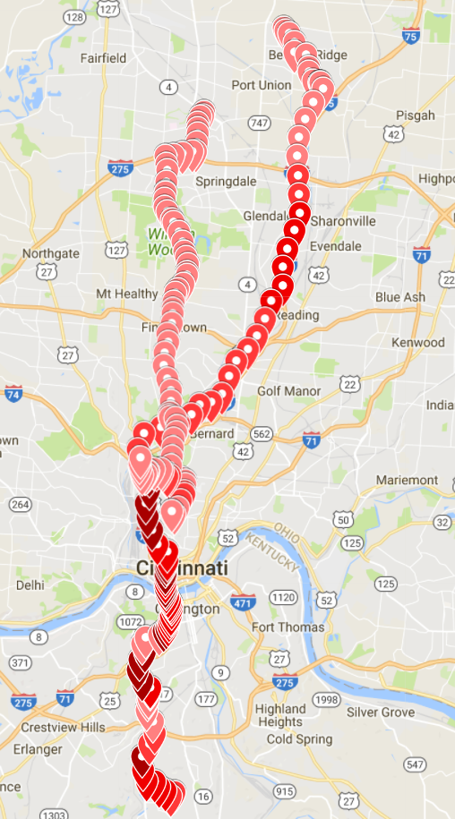
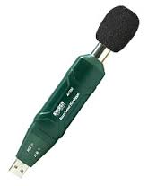
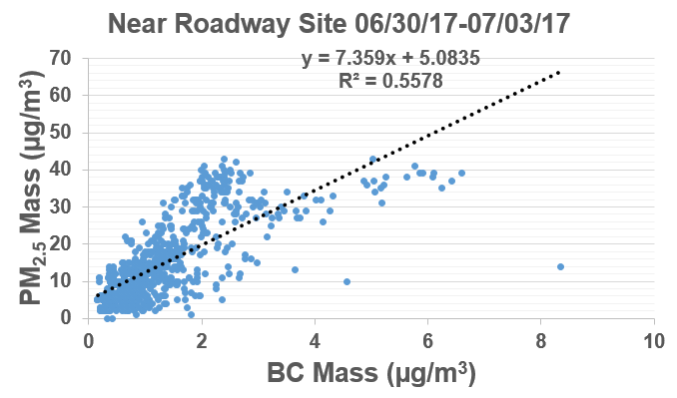
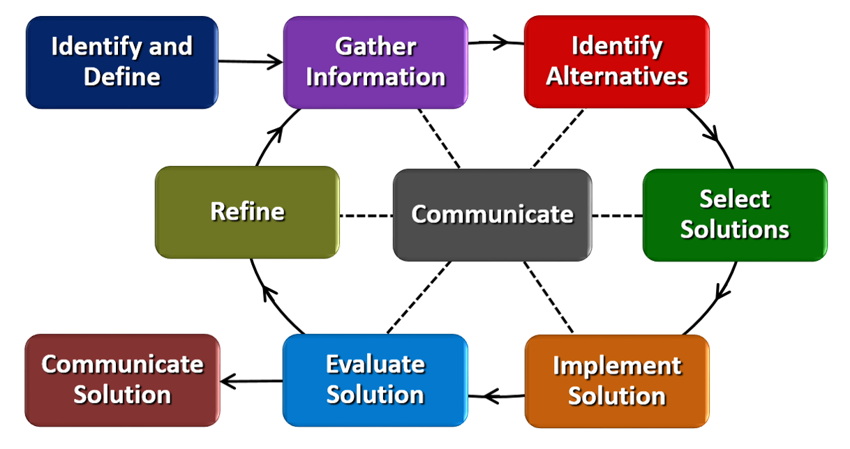
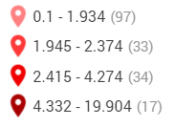
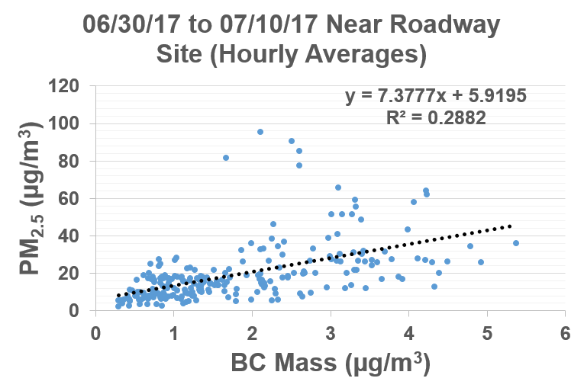
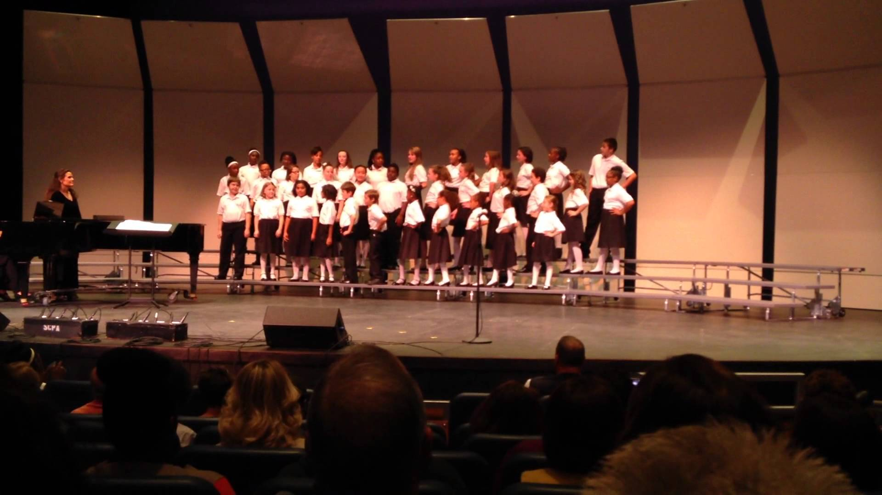
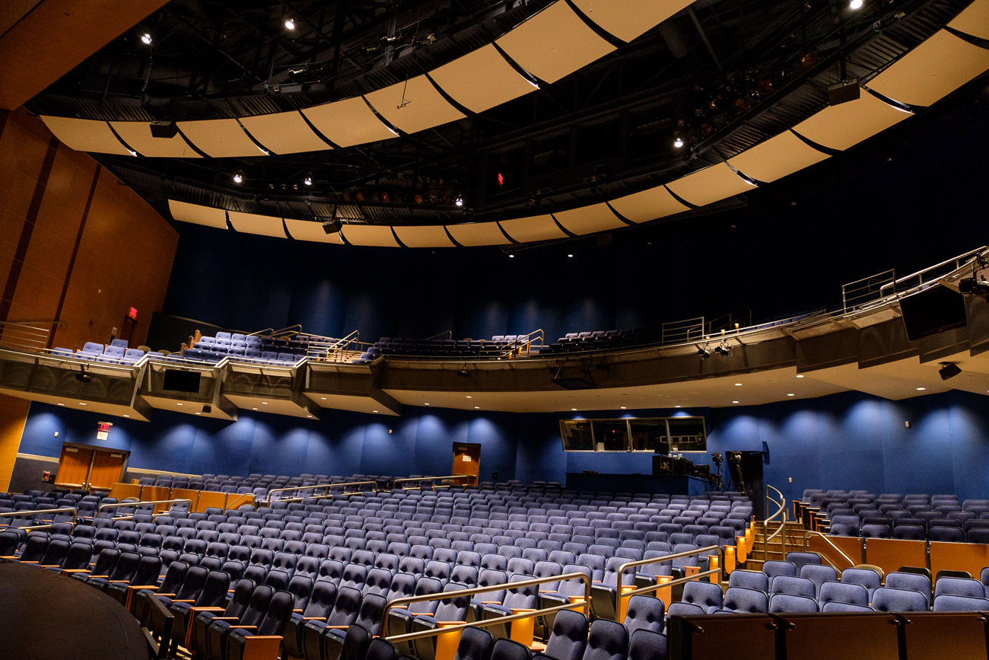
Air and Noise Pollution Molly Hamilton School for Creative and Performing Arts, 10-12 Mathematics
RET is funded by the National Science Foundation, grant # EEC-1404766
What I did this summer…
What you will do…
Have you wondered about…
Collected and analyzed air and noise pollution from micro-environments.
Near I-75
Commutes
Shuttle bus
Walking
Identify a sound problem
you can solve.
Use the Engineering Design Process to find the best solution.
Sound measurement
Sound volume
Safe noise levels
Hearing loss
Sound manipulation
07/05/17 Commutes to UC
Black Carbon Mass (µg/m³)
Sound data from 06/27/17 At Near Roadway Site
http://www.starkey.com/blog/2017/05/Tinnitus-from-loud-music
http://www.extech.com/display/?id=14225
https://www.youtube.com/watch?v=3yps6SDLf4w
http://cincinnatirefined.com/arts-design/photos-inside-cincinnati-
school-for-creative-and-performing-arts-in-over-the-rhine#photo-24

